Slide 1

Invercargill City Council Proposed Plan Change 2
Housing and Code of Practice
Presentation in support of evidence of Dr Virginia McLaughlin

Slide 2

Quick Stats for Invercargill

Slide 3
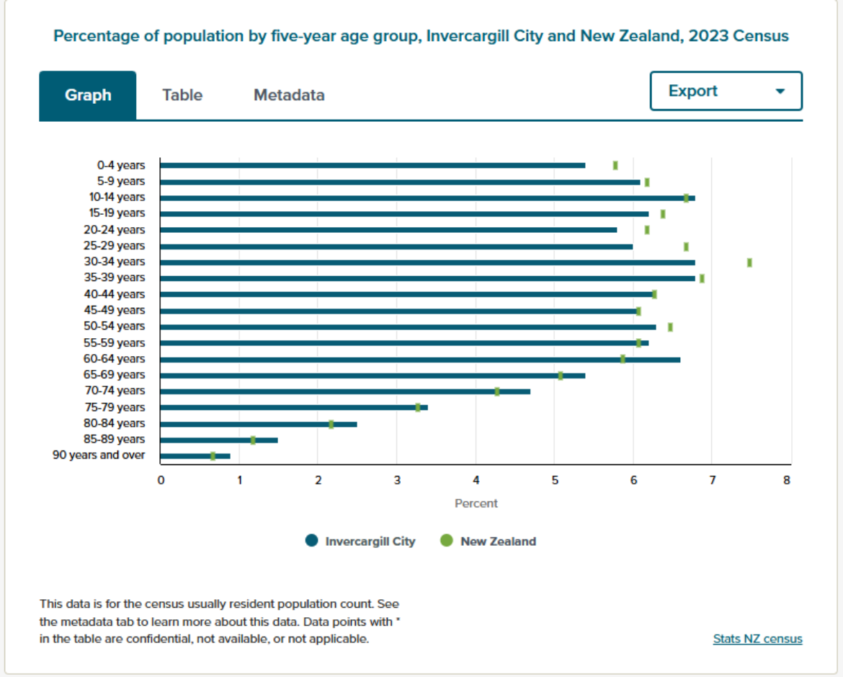

Slide 4
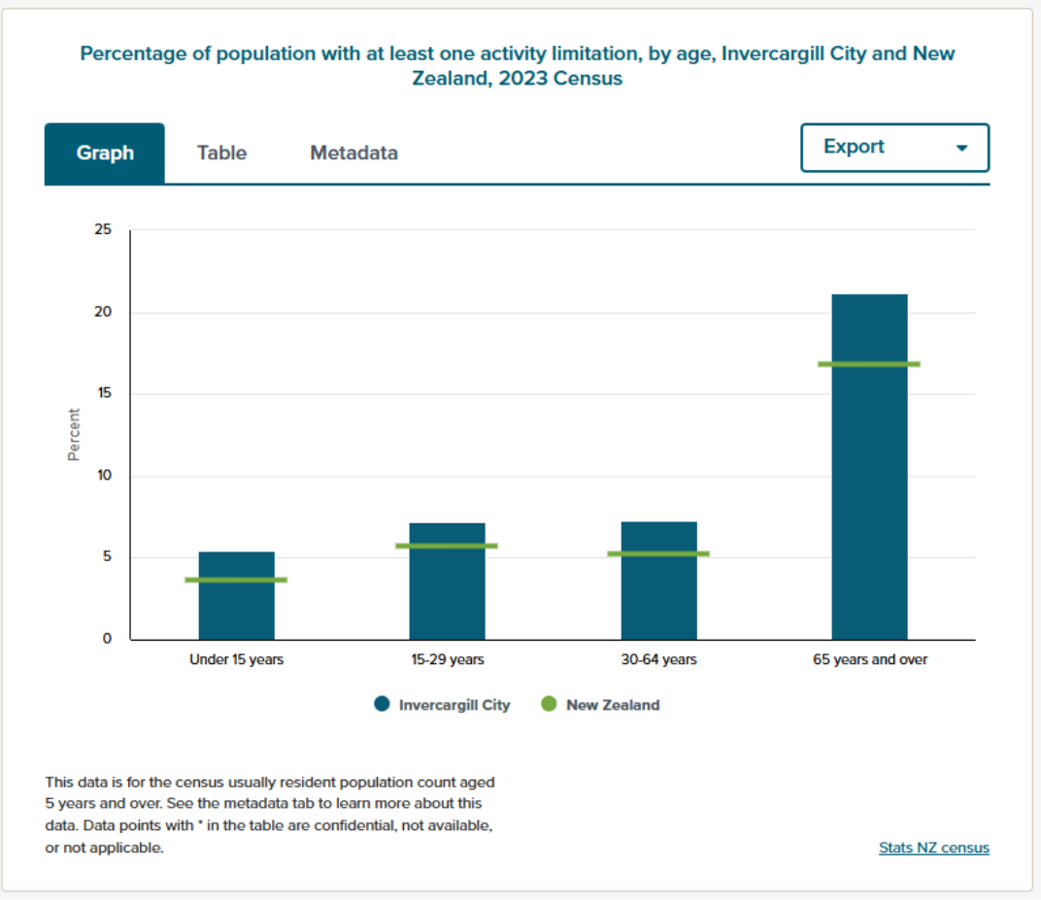

Slide 5
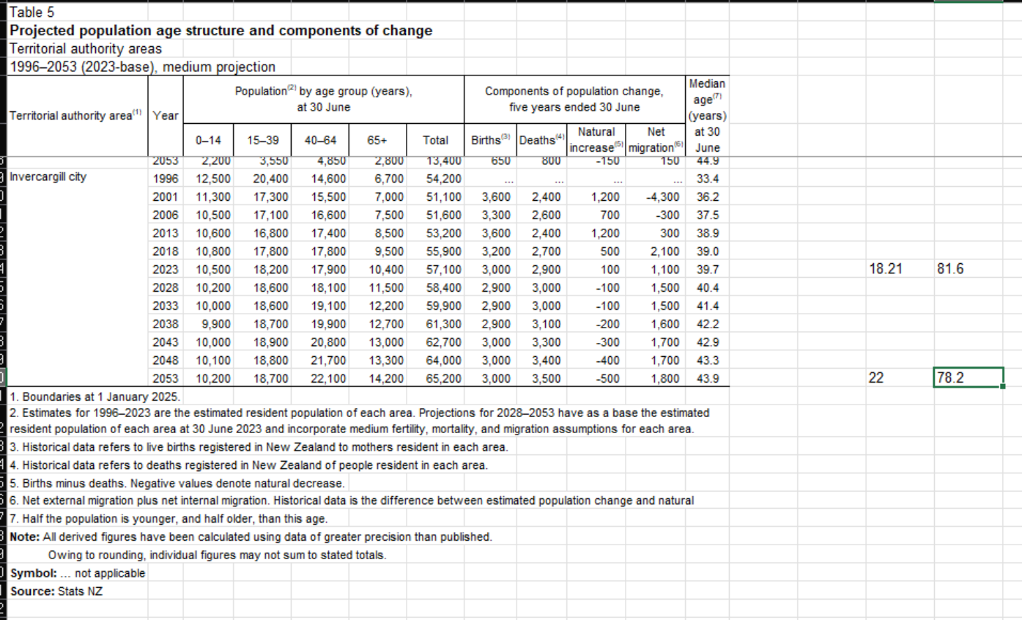

Slide 6
