Slide 1


Tips and tricks for Immigrant Job Seekers
Gary Andrews
Manager – People & Capability
Invercargill City Council
(and also an Immigrant)

Slide 2
Landing that dream job
Before looking for a job ask yourself:
What do I want to do?
What can I do?
What have I done before?
What do I enjoy doing?
What are my limitations? (Working hours, travel, experience)
What do I need to earn?
Most importantly - be honest with yourself and be realistic!

Slide 3
Landing that dream job
How? Use the 5 P’s
Proper Preparation Prevents Poor Performance
Step 1 Prepare your mindset
Step 2 Prepare your CV
Step 3 Prepare your application
Step 4 Prepare for interview
Step 5 Prepare yourself

Slide 4
Landing that dream job
Step 1
Prepare your mindset
Research the role – use the internet, ask for a Position Description
Do I need to step backwards to move forwards?
Research the company – Google is great!
Ask around and use your contacts/networks
Walk in or do a drive by
Ask yourself – Is this job right for me? Is the Organisation right for me? Can I work here?

Slide 5
Landing that dream job
Step 2
Prepare your CV
Academic qualifications: Does the position you are applying for require a specific qualification? Are you able to verify the level (NZQA) of your qualifications essential to the job? If you lack qualifications have you done other forms of relevant training?
Timelines Do the dates on your CV add up? Are there any gaps? If so add a comment to explain them.
Work Experience and Achievements – State clear evidence of stability and commitment. Ensure that you have valid reasons for changes in employment. State specific accomplishments such as ‘increased sales or reduced costs by x%’ as measurable evidence of your worth.
Space filling - Beware of filling your CV with ‘fluff’, such as irrelevant memberships, inappropriate personal data and so on.
Hobbies and interests - Beware, what you list under this can give an insight into your personality (‘socializing with friends’ can easily be translated into ‘always drinking with mates’). If you have an interest that aligns with the role you are applying for then highlight it, e.g. a keen cyclist applying for a position in a bike shop, if not leave it out.

Slide 6
Landing that dream job
Step 2
Prepare your CV
Knowledge: Use statements that describe and highlight your relevant knowledge, particularly where these align with the requirements of the job you are applying for.
Transferable Skills: Describe what you can bring to the role in regards to relevant and transferable skills, again highlight those which align with the role.
External Validation: Winning awards or being selected to chair working group meetings rarely happen to underperforming individuals so use these to your advantage.
Promotions: Steady and consistent promotions are a good indicator that you can sustain the enhanced job responsibilities and that you are highly regarded.
Unsubstantiated Statements: Beware of claiming to be “commercially astute” yet fail to list one commercial achievement.
Photographs: Do not use photographs (unless you are applying to be a model!) as they allow for the potential to discriminate on the basis of age, gender, race etc.

Slide 7
Landing that dream job
The perfect CV?
Overall impression - How legible is your CV? Is it well laid-out? Does it have lots of mistakes? Get someone (with good English) to proof read it for you. Use spell check!
Layout - Does your CV lead the reader logically through your work history, rather than leave them searching for relevant information? CV’s that flow clearly show painstaking preparation. CV’s that are difficult to read may have something to hide and, at the very least, indicate a lack of care taken over this important self-presentation document.
Tailored targeting – Have you taken the time and trouble to tailor your CV to the position advertised? Does it demonstrate compatible skills or the experience that has been asked for? Does it highlight how you meet their needs? The covering letter is often used for this purpose but a tailored CV will highlight you as a candidate that is willing to be thorough and to go the extra mile. Read the advert and if available the Position Description and make sure that your CV highlights your experience in the key areas of the role (don’t exaggerate or lie as you will get caught out)!
Contact information - Look at the address, phone and email details. Given this is for professional scrutiny, is the email address appropriate or frivolous? lazybeermonster@gmail.com is not a good look!

Slide 8
Landing that dream job
Step 3
Prepare your application
Read the advert properly – then read it again!
How do they want you to apply? Telephone, email, in person?
Write a targeted covering letter to highlight your suitability for the job and send this with either your CV or Application Form. Use proper English, an email sent from a phone saying ‘hi m8 i am just asking about getting a job with ur company’ will not get you very far!
Apply and then follow up if your application is not acknowledged

Slide 9
Landing that dream job
Step 4
Prepare for the interview
Take a good long hard look at your CV – What questions would you ask yourself? Prepare your answers!
Have a written list of appropriate questions that you want to ask the interviewer. (Asking about break times, promotions and pay are not appropriate for a first interview)
What to wear? Kiwis tend to be less formal in their dress
How am I going to get there? Parking? Public transport?

Slide 10
Landing that dream job
Step 5
Prepare yourself
Self-Awareness and Maximising Your Personal Impact
“Know thyself” has been the advice given to people for millennia.
If you want to stand out from the crowd then you need to be self aware.
Each of us should be aware of our own impact, our strengths, our weaknesses, and our values, as well as being able to walk the talk when it comes to our personal character and motivations.
Displaying such self-awareness inspires people, people will want to hire you as you will be able to lead by example and as a result you will create more authentic relationships based on mutual trust, collaboration and ownership of performance.

Slide 11
Landing that dream job
The interview
It starts as soon as you walk through the door – be nice to everyone!
The types of questions that you could be asked:
Open
Purpose: to actively involve someone in a conversation and gain lots of information, general or specific
Closed
Purpose: to obtain specific information quickly and keep a tight rein on the conversation
Competency
Questions which give the interviewer an insight into a candidates previous behaviour which are then used to predict future job performance.
1) Over the last year, what did you consider to be your main achievements?
• What difficulties did you encounter? How did you overcome these?
2) What was the biggest setback/failure you’ve had at work?
• How did you deal with it? How have you prevented it from happening again?

Slide 12
Landing that dream job
Post interview
Self reflect – what went well, what didn’t go so well?
Could I have used better examples when answering questions?
How did I come across?
What could I do better next time?
Is it the job/company for me?
Job offer
Congratulations! Now it is time to show them what you can do!
No offer
Ask for feedback and act on it so that you are ready for your next interview.

Slide 13
Landing that dream job
Job offer - Know your rights!
National Minimum Wage - Minimum wage rates apply to all employees
Every employee must have a written employment agreement
Rest and meal breaks – an eight-hour working day must have at least two 10-minute paid rest breaks and one 30-minute unpaid meal break.
Annual holidays and Public holidays – Annual leave is 4 weeks per year with 11 paid Public Holidays
Sick and bereavement leave – Entitlements available after 6 months continuous employment. 10 days sick leave and either 1 or 3 days bereavement leave dependent upon relationship.
Family violence leave – special employment provisions for affected people
Parental leave and parental leave payments – for leave to care for a child
Employers must, by law, give you enough time to seek professional advice before signing an employment agreement
www.employment.govt.nz
0800 20 90 20

Slide 14
Great South’s Skill Placement Programme
For who?
  Skilled migrants and family: Unemployed or unskilled job
  International students: Bachelor’s level and above
Offered services
  Connecting skilled migrants with employment opportunities in Southland.
  Assisting with workshops and through the recruitment process.
  Finding suitable employment for your spouse.
Contact person
  Shanaye Jenkins, Great South’s Skills Placement Coordinator
  03 211 1806, shanaye@greatsouth.nz

Slide 15
Working at ICC
403 staff – over 200 different types of roles
Range of full time, part time and casual working patterns
Wide range of skills and experience needed with some of this provided by 33 current Staff who are on work visas
All of our vacancies are advertised here https://icc.govt.nz/your-council/careers

Slide 16
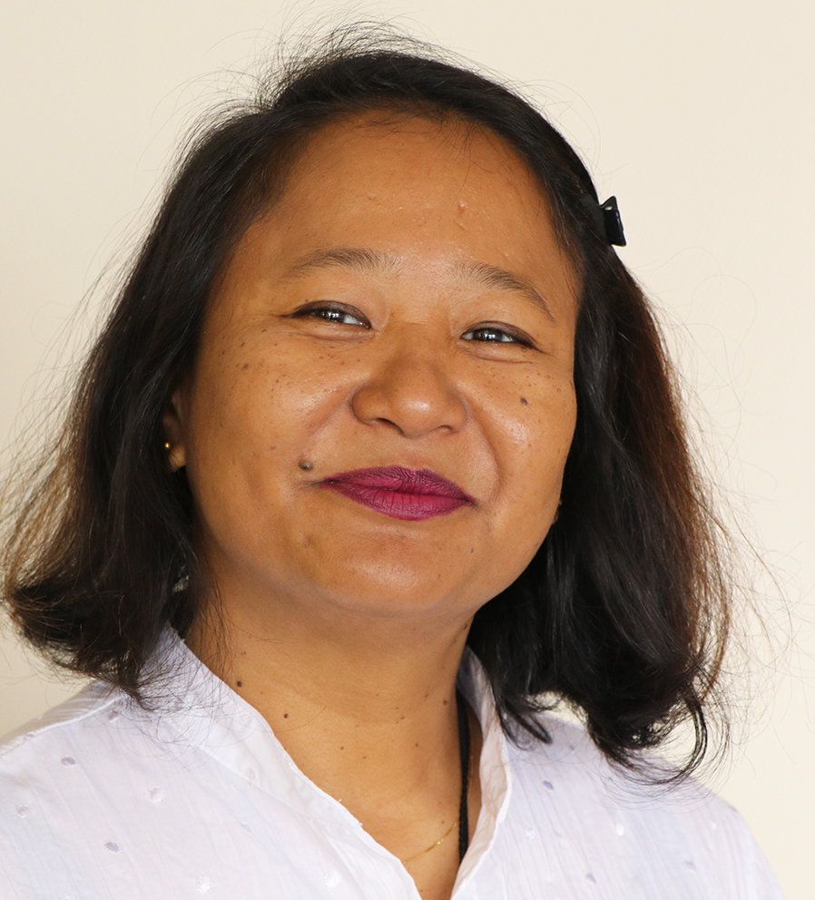
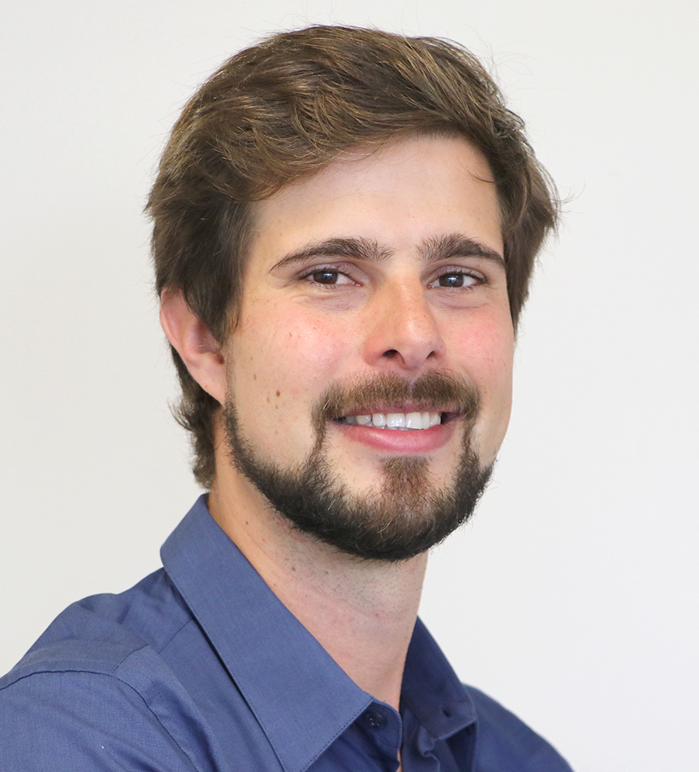
Malavika Cassiere
ICC Executive Governance Officer
Gill Caron
ICC Communications Advisor

Slide 17
Thank you for your attention
Any Questions?

